Slide 1
Masterpieces Ltd
Painting hair system

Slide 2
Team’s Names
Doaa Khaled El-Sayed Abd El-Khaleq
Eman Ahmed Abd El-Tawab
Khaled Mustafa Hussien Mahmoud
Khaled Nabil Hassan
Reham Raafat Shokry Garas
Rekah Mohamed Abd El-Fatah

Slide 3
Outline
Introduction
Problem Definition
Objectives
Related Works
Time Plan
System Analysis
System Design
Implementation
References

Slide 4
Introduction

Slide 5
Introduction
This system is a management system for painting hair foundation in which various sections of the administration. Each department contains information related to its owner.
Each section is concerned with their data from name, date of attendance and date of arrival to the organization and color Chosen by its designer.
System reduced paper based deals and makes managing of foundation be easier than it was before.

Slide 6
Problem Definition

Slide 7
Problem Definition
paper system founded on the basis of several institutions resulted in many mistakes, So, we developed a system automate data processes and manage the foundation easily with out missing the data or less occurrence which reduce possible errors

Slide 8
Objectives

Slide 9
Objectives
Our system makes management fast and easily.
Our system is Accurate in Accounting and Saving Data .
The Customer Can Choose Requirements and Act With The System from The Internet.
Implement This System to Get Project successful.

Slide 10
Related works

Slide 11
Related Works
Behind the chair
Neville Hair & Beauty.
Hair ware Beauty ware
Neroli Salon

Slide 12
Time Plan

Slide 13
Time Plan
Activity Network
Gantt Chart

Slide 14
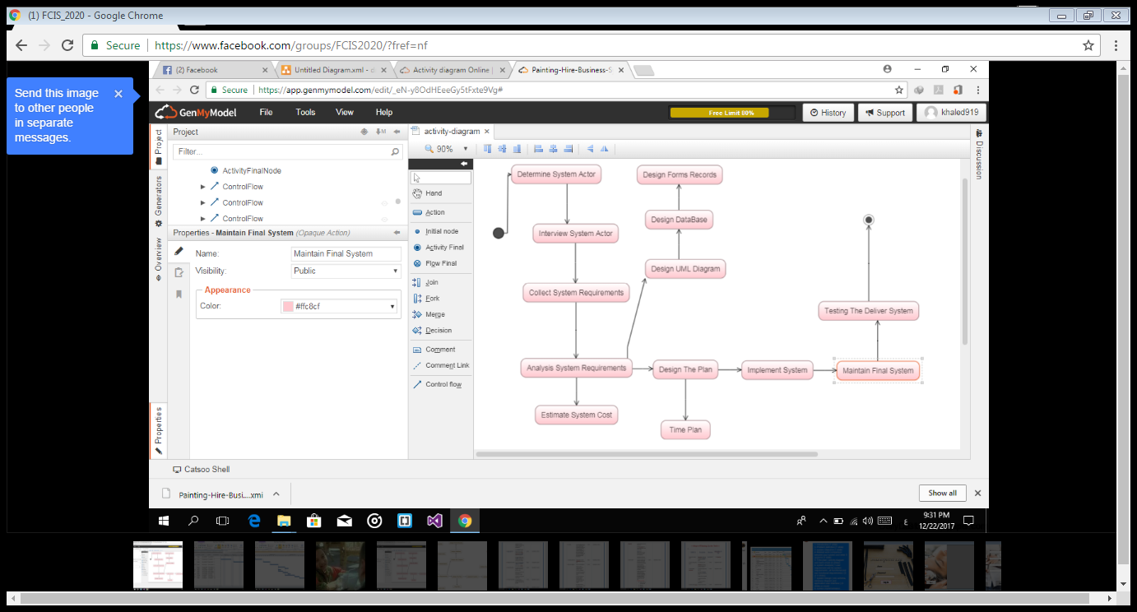
Activity network

Slide 15
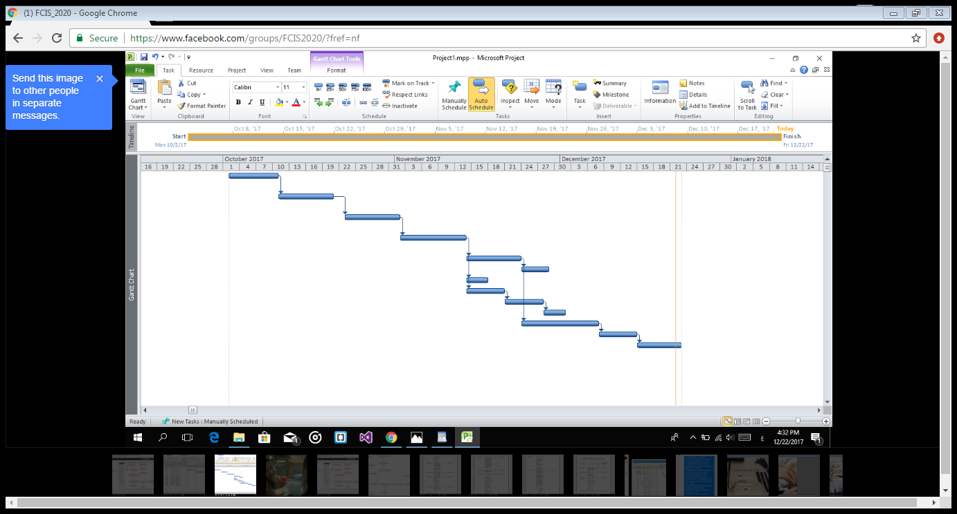
Gantt Chart

Slide 16
System Analysis

Slide 17
System Analysis
User Requirement
System Requirement
Functional Requirement
Non-Functional Requirement

Slide 18
User Requirements:
In which we put requirement’s of the user in the system
Ex :
The system abounds that each painting can only have one artist associated with it.
Each user can choose specified hair color.

Slide 19
System Requirements:
In which we put requirement’s of the system to achieve User requirements.
Ex :
4.2 – the admin will check the data.
4.2.1 – if the data correct he will login.
4.2.2 – if the data is not correct he won’t login.

Slide 20
Functional Requirements:
In which what the system shall do .
Ex :
1.1System will compare the name of client if exist or not.
2.1-manage the details of customers, paintings and those paintings currently on hire to customers.

Slide 21
Non-Functional Requirements:
In which what the User should do.
Ex :
1.1-The admin will enter the name of clients.
2.1-Customers Take discount of 0%, 5%, 10% or 15% respectively if chose categorized as
B(bronze), S (silver), G (gold) or P (platinum).

Slide 22
System Design

Slide 23
System Designs
ERD Diagram
Database Diagram
Schema
GUI ( Graphical User Interface)

Slide 24
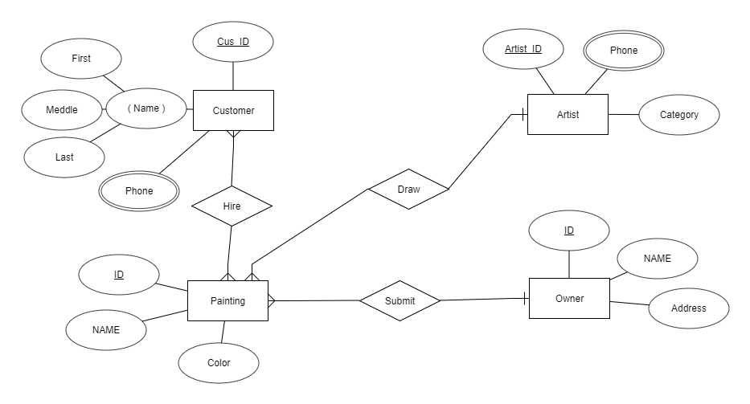
ERD diagram

Slide 25
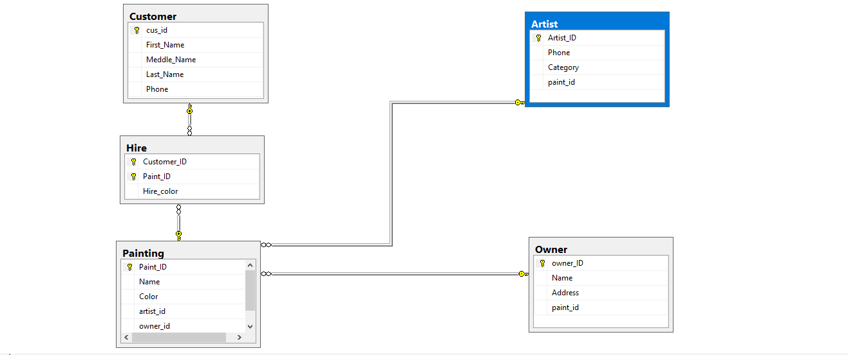
Database Diagram

Slide 26
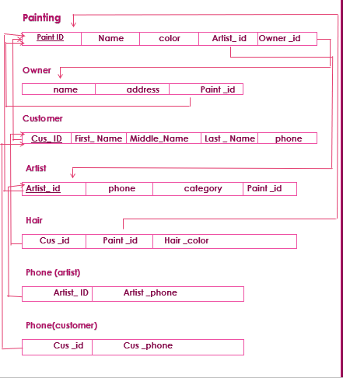
Schema

Slide 27
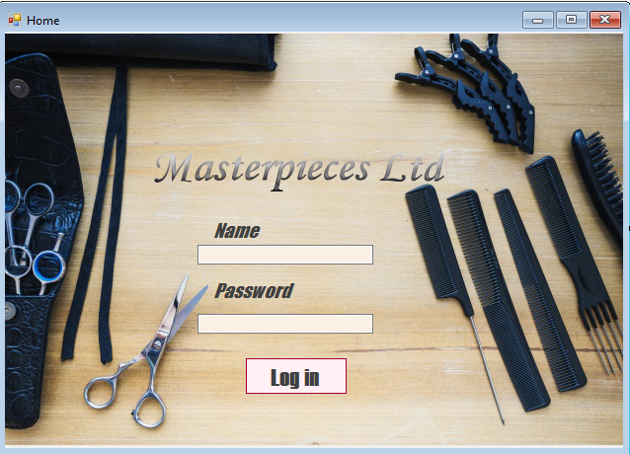
Gui
This is the first form which appears to the user when he open the program

Slide 28
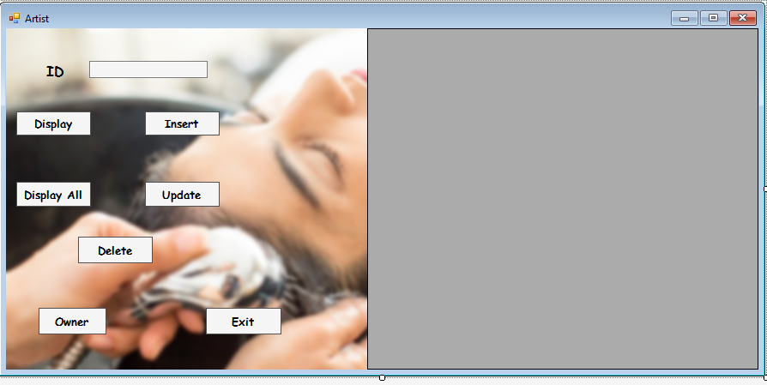
Gui
After Entering the correct password program turn to the next form of Artist

Slide 29
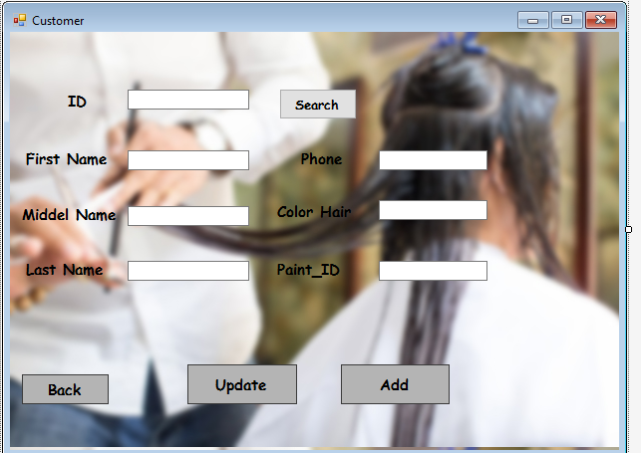
Gui
If user checked insert button, program will turn to the next form ( customer form)

Slide 30
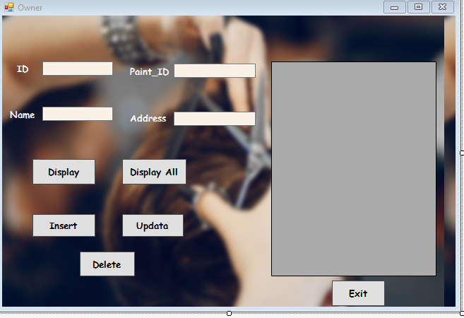
Gui
When user check owner button, program will turn him to the next form ( owner form)

Slide 31
Implementation

Slide 32
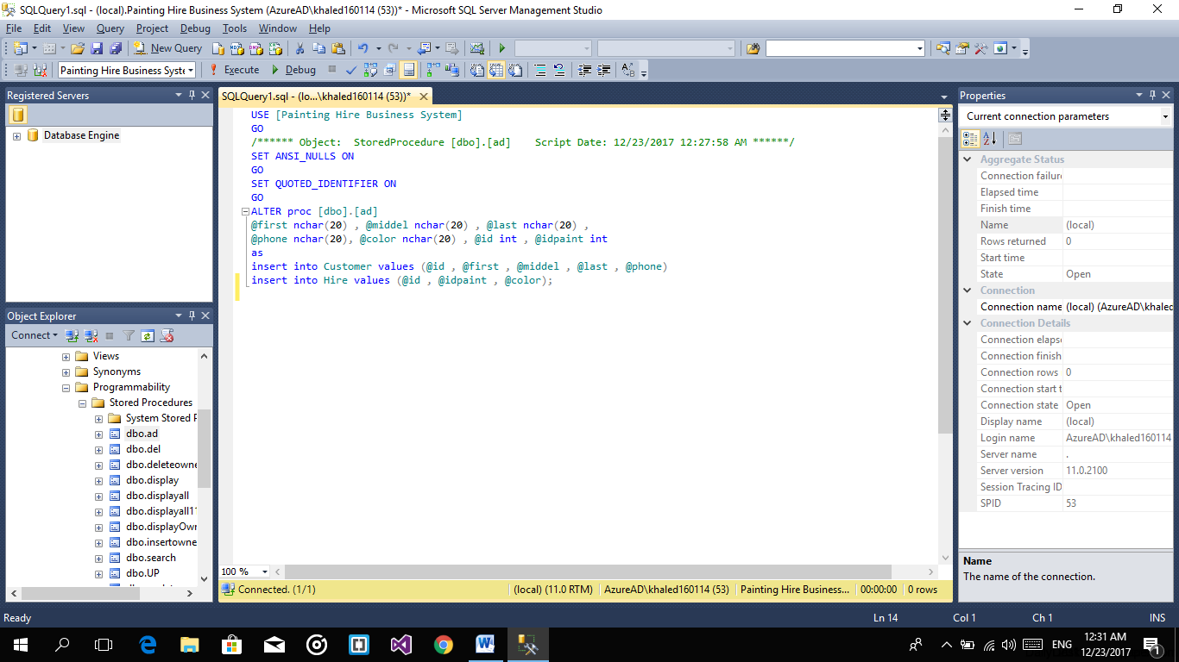
In stored procedure (ad)
stored we add input data into our database in two table Customer and Hire.

Slide 33
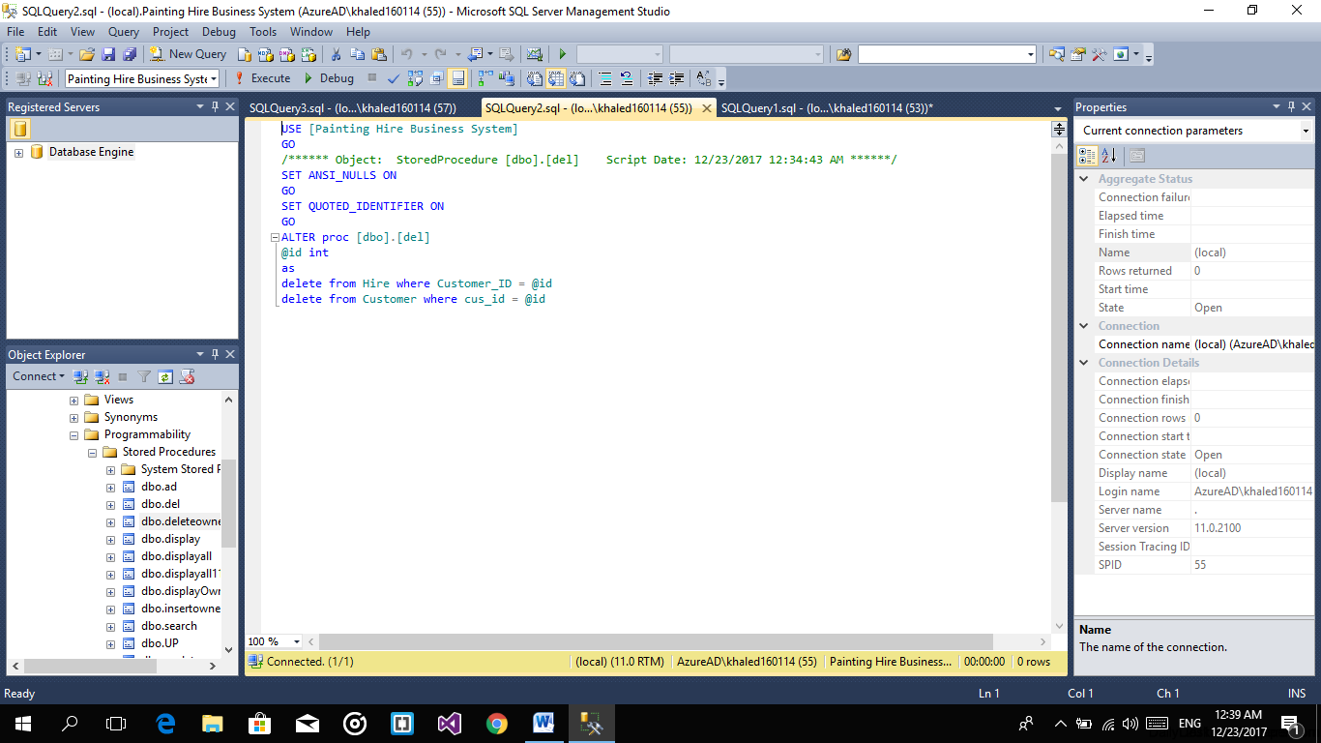
In stored procedure (del)
Delete specific input user choose and delete all related data in other tables

Slide 34
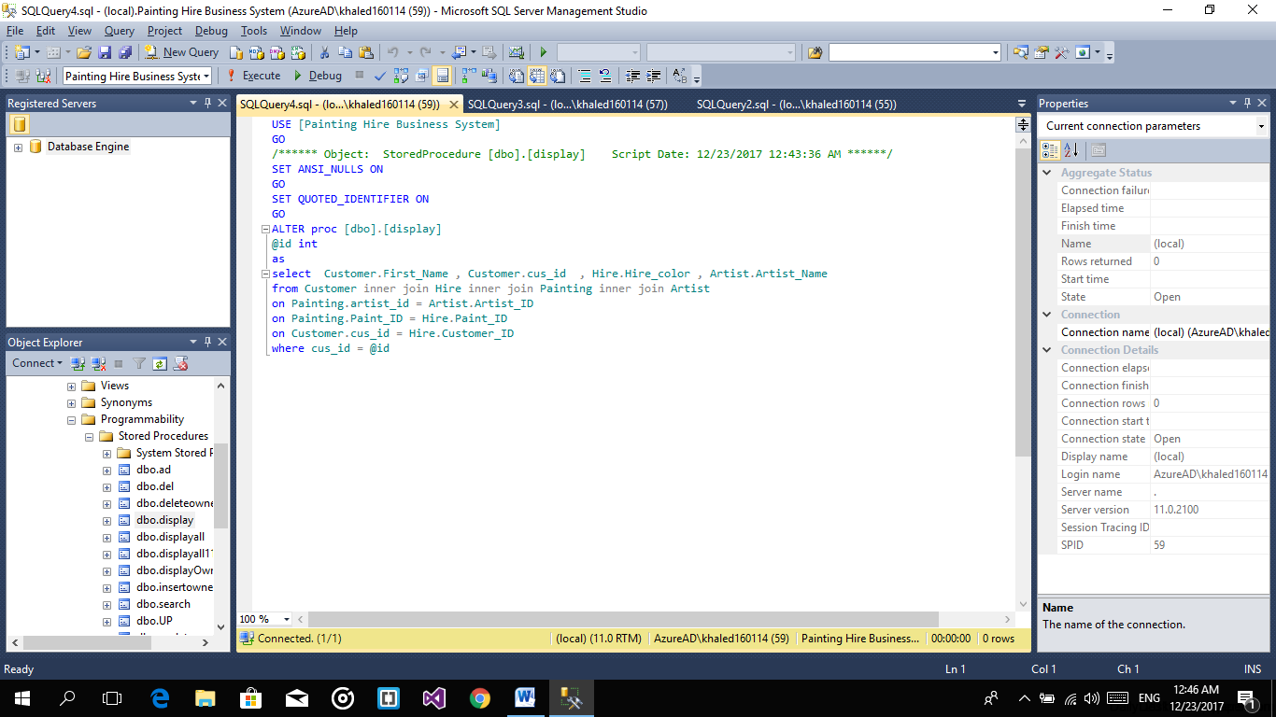
In stored procedure (display)
will Display specific input data and show all data about it in the grid system

Slide 35
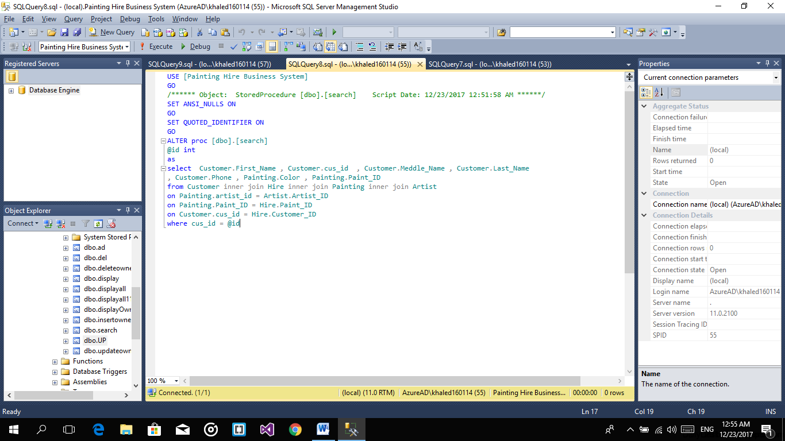
In stored procedure (search)
search a specific id and put all data belongs to this id in a specific text box

Slide 36
In stored procedure (up)
update data which id user chose and update all data in database and save it

Slide 37
In stored procedure (display all)
In this stored we will Display data and show all in database in the grid system

Slide 38
References

Slide 39
References
Visual Studio 2015 (C#)
SQL Server 2012
Microsoft Project Management
https://dashboard.genmymodel.com/
Project Link : https://drive.google.com/open?id=1Qp-1S0QX1FWpYFeGzUxgdyiazvR_Rb3O

Slide 40
Thanks

